Slide 1
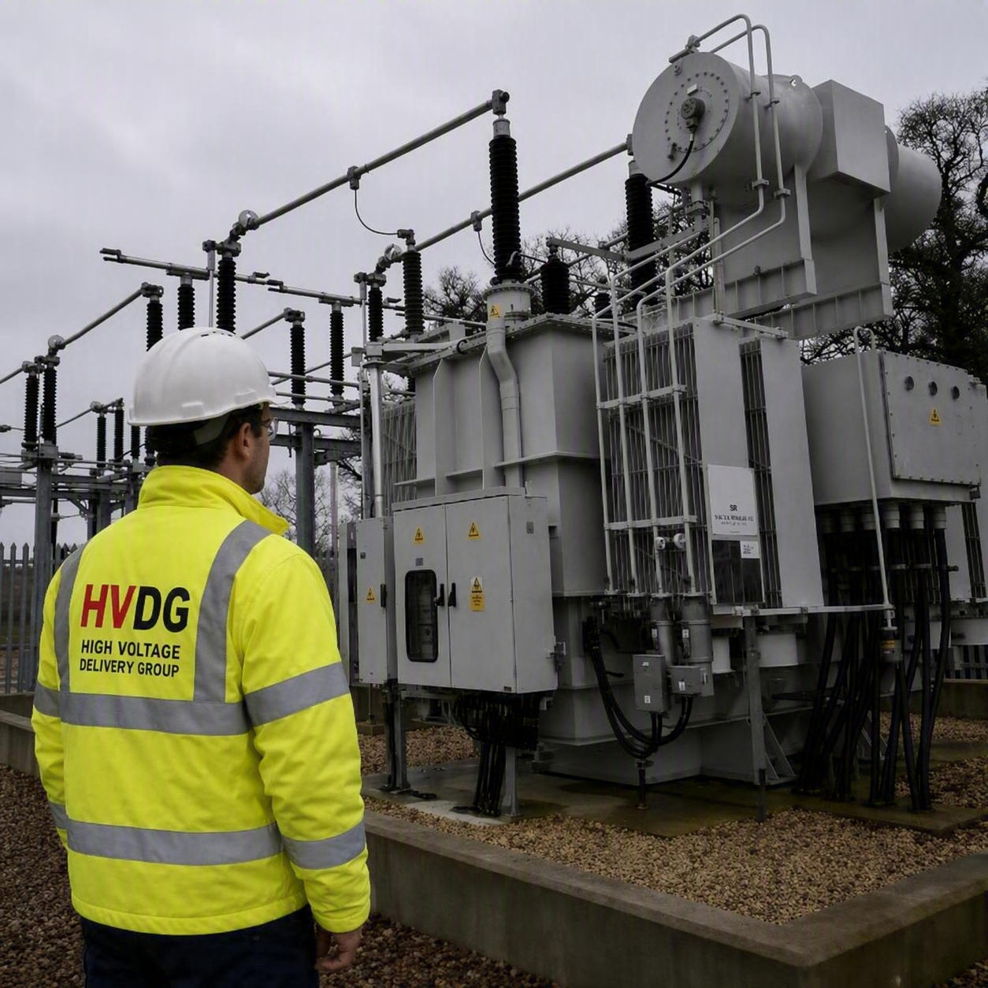
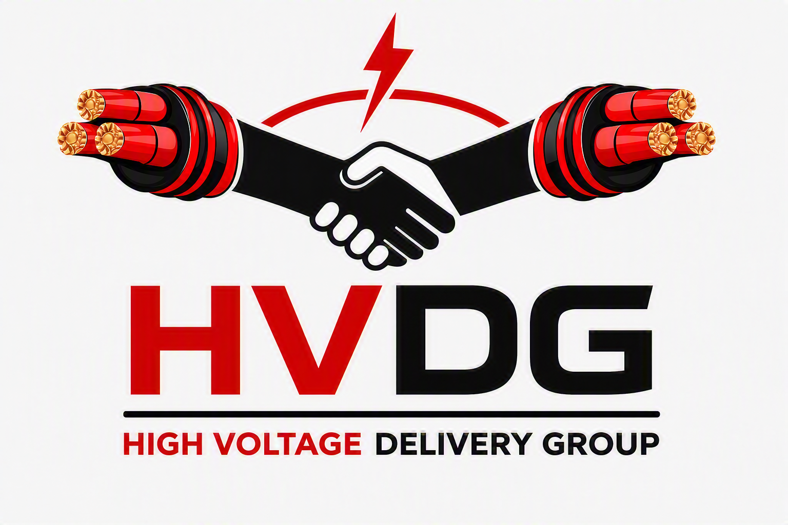
Company Overview & Introduction:
HIGH VOLTAGE
DELIVERY GROUP LTD
(HVDG)
ICP & BoP Contractor
Partnership led, people first, selective. The clients we work with get our best team, every time.
Grid connections, substations and renewables, energised on programme by a team that has done it before.
40+ years of founder led project delivery, up to 400kV. High performing expertise guaranteed.
ICP Up To 132kV
BoP Delivery Up To 400kV
Full Turnkey
Delivery
Mike Reed: Founder & Managing Director
20+ years in HV delivery. Most recently led regional operations for a Tier 2 ICP and BoP contractor, scaling it from £70m to approx. £300m turnover across 33kV to 400kV TSO/DNO/BESS/Solar/Wind projects. Building a new team and office in Bristol to enable successful delivery of growth.
……………..: Founder & Technical Director
20 years in engineering, procurement and construction, wide ranging ICP knowledge. Built and Lead designer, construction and commissioning teams from 11kV to 400kV across National Grid transmission, HV substations, BoP, BESS and Solar.
Notes:
[Sources]
User requested a 132kV AIS compound with transformer and primary plant visual style for page 1.
Visual on this slide was generated with Microsoft Copilot where applicable.

Slide 2

TURNKEY CAPABILITY
ICP & Balance of Plant Delivery
Full delivery ownership for HV connections and energy infrastructure, from early buildability through to energisation and handover.
ICP Project Delivery Up To 132kV
Balance Of Plant Contractor Up To 400kV
Commissioning & Energisation
Grid Connection Delivery: DNO/IDNO interfaces, contestable delivery and non-contestable coordination.
Design, Engineering & Procurement: full ownership from concept through to delivered plant.
Electrical BoP: HV/LV cabling, jointing, terminating and testing, auxiliary supplies, containment, small power and lighting.
Primary plant and control systems: switchgear, transformers, instrument transformers, protection and control, SCADA and earthing.
Civil and substation BoP: grid route trenching and ducting, substation buildings, foundations, T&D, SUDS and fencing.
Testing, commissioning and energisation: grid code and TSO/DNO/IDNO compliance testing, G99 witnessing, through to handover
Principal Contractor and assurance: CDM duties, O&M manuals, as-builts, asset data and adoption packs
Design, Engineering and Procurement: full ownership from concept through to delivered plant.
Civil, structural and architectural BoP: access roads, earthworks, SUDS, foundations, substation compound, buildings, T&D, fencing and landscaping.
Electrical BoP: HV/LV cabling, jointing, terminating and testing, auxiliary supplies, containment, small power and lighting.
Primary plant and control systems: switchgear, transformers, instrument transformers, protection and control, SCADA and battery systems, package substations, earthing and lightning protection.
Client systems and site services: BESS containers, inverters, PCS, fire and intruder alarms, CCTV, BMS, site-wide infrastructure coordination.
Testing, commissioning and energisation: grid code and TSO/DNO/IDNO compliance testing, G99 witnessing, through to handover
Principal Contractor and assurance: CDM duties, O&M manuals, as-builts, asset data and adoption packs
Test planning and readiness: inspection and test plans, pre-energisation checks, CP/AP/SAP and control room coordination.
Testing and commissioning: factory and site acceptance testing, pre-commissioning and functional testing, protection and control injection, end-to-end and tripping tests, transformer oil sampling and DGA, SCADA point-to-point and telecoms proving.
Energisation and switching: safety rules, switching schedules and documentation, outage planning and applications, soak testing, first-time energisation, export ramp-up and grid compliance monitoring.
Handover and assurance: snagging and completion certificates, asset registration, adoption and DNO/IDNO takeover, O&M manuals, as-builts and asset data packs, operator training, spares and warranty support.
One accountable contractor, a proven high performing team and a well trusted delivery model built around getting connected.
Notes:
[Sources]
The prior HVDG deck states HVDC material lists design, installation, jointing, testing, commissioning, energisation, project management, Principal Contractor and BOP capability.
User requested repositioning as a full turnkey contractor rather than independent advisory.

Slide 3
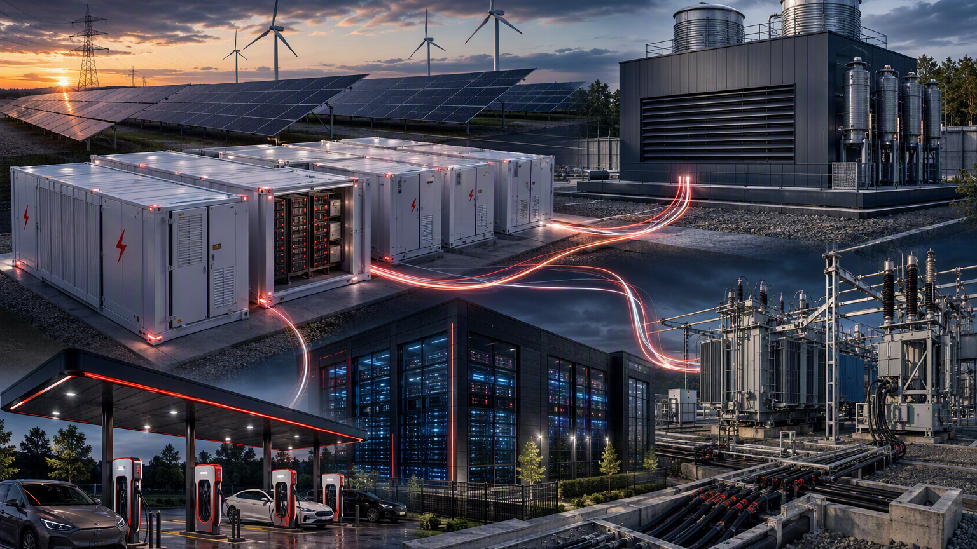
MARKETS
Where HVDG Wins
Focused on the project types where HV connection certainty, contractor control and energisation discipline matter most.
Battery Energy Storage Systems
Wind Farms
Solar Farms
EV Charging Stations
Data Centre Substations
Private Networks
Substation Network Upgrades
TSO/DNO/IDNO Networks
Synchronous Condensers
HVDG is built for BoP renewable, HV pathfinder critical power projects where failure to delivery quality and energise on time carries real commercial consequences.
Notes:
[Sources]
The previous HVDG deck lists BESS, solar farms, EV infrastructure, data centres, private networks and grid connection sectors.
User requested adding synchronous condensers and positioning as renewable energy project contractor.
Visual on this slide was generated with Microsoft Copilot.

Slide 4
HOW WE PARTNER
Selective, Focused, Accountable
HVDG does not chase every project. The business is built around the right clients, the right partners and the right delivery conditions internally and externally.
01
02
03
04
Select
Build the team
Drive delivery
Energise well
Work where HVDG can add real delivery value and align with capable clients and supply chain partners.
Put the right leadership, engineering, project, site and commissioning people around the project.
Set clear ownership, workload, communication routines and programme discipline from day one.
Treat energisation as the project outcome, not a final administrative milestone.
High performing teams are not an accident. They are selected, led and protected.
Notes:
[Sources]
User requested partnership-focused, people-focused, delivery-focused positioning and selective choice of clients and partners.

Slide 5
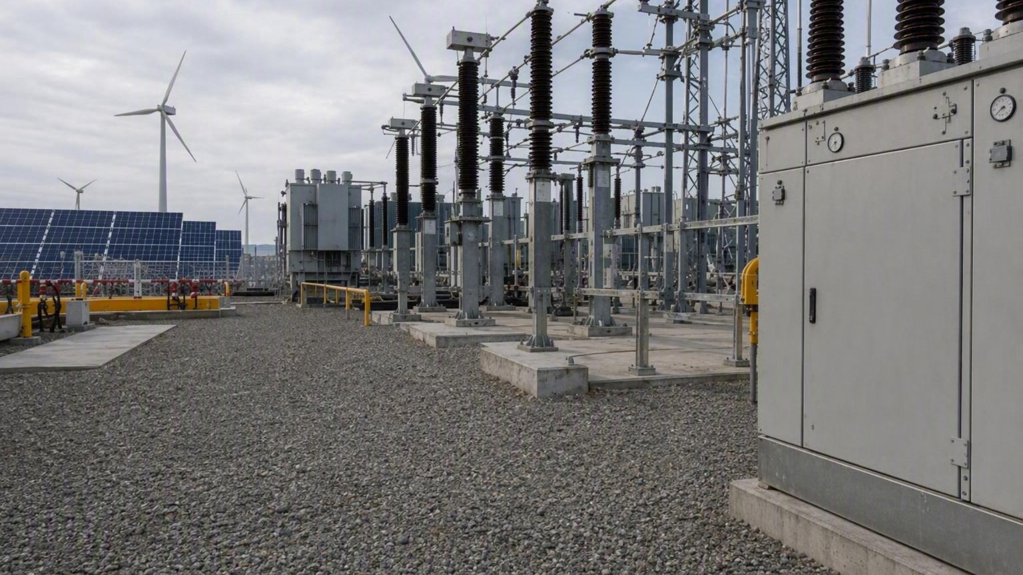
WHY CLIENTS CHOOSE HVDG
Confidence Under Pressure
A client-facing contractor that sells certainty, control and senior ownership from the first meeting to the final energisation.
Founder Led Delivery
Senior experience and decision making close to the project, not hidden behind layers.
Proven Project History
40+ years across complex HV, grid and renewable infrastructure delivery.
Full Accountability
A turnkey contractor focused on programme, safety, quality and commercial outcomes.
People First
Strong teams, straight communication and a culture built around high performing repeated delivery.
Partner Mindset
Collaborative with clients, DNOs, IDNOs, EPCs, developers and specialist suppliers.
Selective Focus
Working where HVDG can genuinely perform and protect client outcomes.
Notes:
[Sources]
User requested selling the company, founders/directors, 20-year delivery history, high-performing teams and selective partner approach.
Visual on this slide was generated with Microsoft Copilot where applicable.

Slide 6
From Connection Strategy To Energisation
HVDG brings the contractor mindset, delivery leadership and project team needed to turn complex projects into energised assets.
The HVDG promise
Full turnkey delivery, trusted partnerships, strong people and relationships, a relentless focus on understanding the clients needs and getting the client successfully connected.
High Voltage Delivery Group Ltd
ICP up to 132kV | Balance of Plant Up to 400kV | Renewable Energy Connections | Critical Power Infrastructure
Notes:
[Sources]
User requested a punchier external company overview and introduction for clients.
Visual on this slide was generated with Microsoft Copilot.

